Slide 1

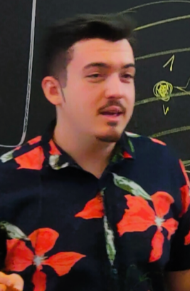



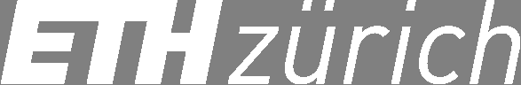
Convex Consensus with Asynchronous Fallback
Andrei Constantinescu Diana Ghinea Roger Wattenhofer Floris Westermann
Distributed Computing Group

Slide 2




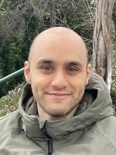
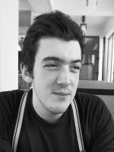


Distributed + Blockchain@DISCO
DeFi
Blockchain
Finance
Theory of
Distributed
Diana Anton Yann Quentin
Mose Andrei Lioba Elio

Slide 3
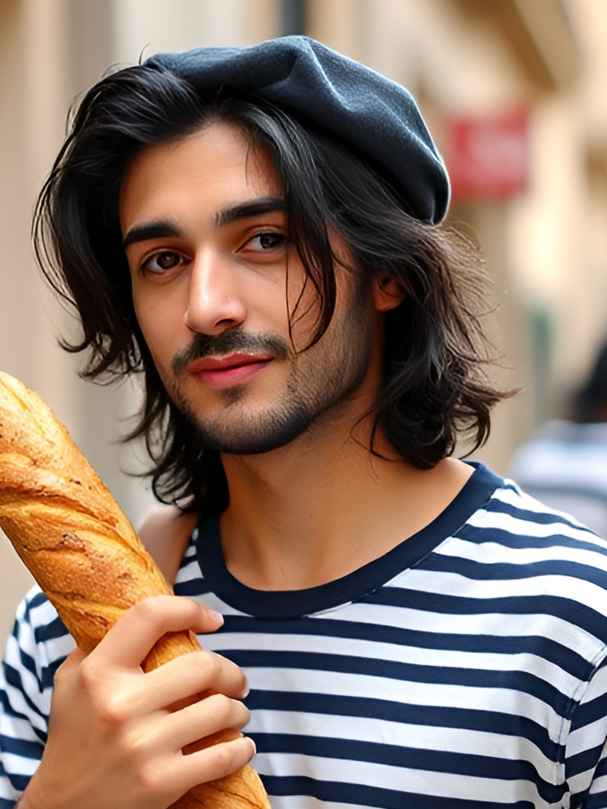
Distributed + Blockchain@DISCO
DeFi
Blockchain
Finance
Theory of
Distributed
Diana Anton Yann Quentin
Mose Andrei Lioba Elio

Slide 4

Distributed + Blockchain@DISCO
Kobi
DeFi
Blockchain
Finance
Theory of
Distributed
Diana Anton Yann Quentin
Mose Andrei Lioba Elio

Slide 5


Distributed + Blockchain@DISCO
Borna
Kobi
DeFi
Blockchain
Finance
Theory of
Distributed
Diana Anton Yann Quentin
Mose Andrei Lioba Elio
Damien

Slide 6
1.
Why Convex Consensus?
(Almost) everything is convex if you believe!
Notes:
Motivating example

Slide 7
Consensus (Byzantine Agreement)

Slide 8
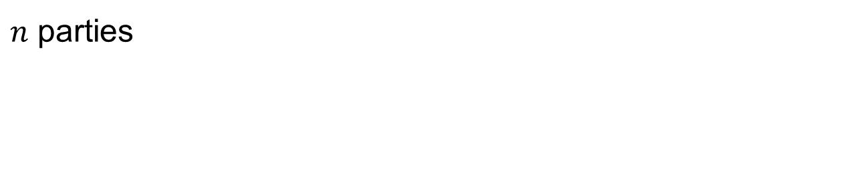
Consensus (Byzantine Agreement)
$n$ parties

Slide 9




Consensus (Byzantine Agreement)
$n$ parties

Slide 10
Consensus (Byzantine Agreement)
$n$ parties
(authenticated bidirectional channels)

Slide 11
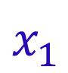
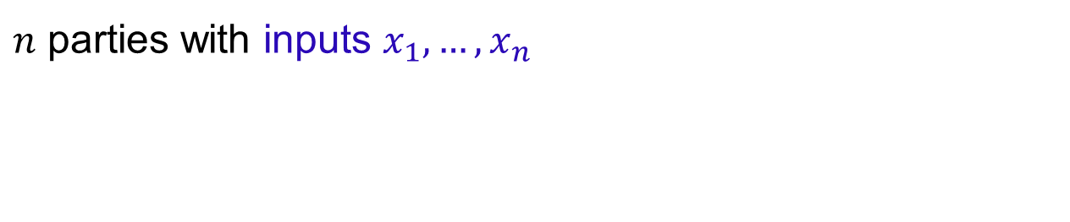
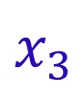
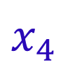
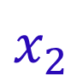
Consensus (Byzantine Agreement)
$n$ parties with inputs $x_{1}, …, x_{n}$
$$x_{1}$$
$$x_{2}$$
$$x_{3}$$
$$x_{4}$$
(authenticated bidirectional channels)

Slide 12
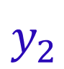
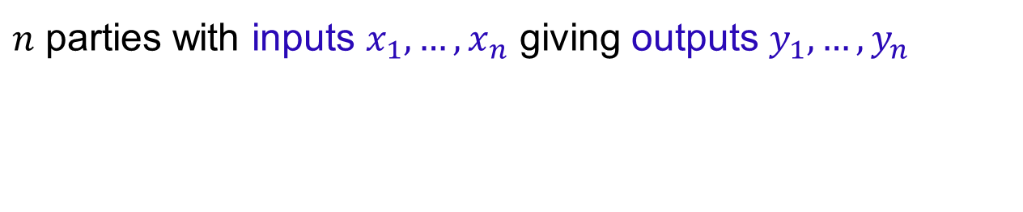
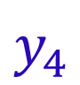
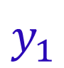
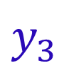
Consensus (Byzantine Agreement)
$n$ parties with inputs $x_{1}, …, x_{n}$ giving outputs $y_{1},…, y_{n}$
$$x_{1}$$
$$y_{1}$$
$$x_{2}$$
$$y_{2}$$
$$x_{3}$$
$$y_{3}$$
$$x_{4}$$
$$y_{4}$$
(authenticated bidirectional channels)

Slide 13

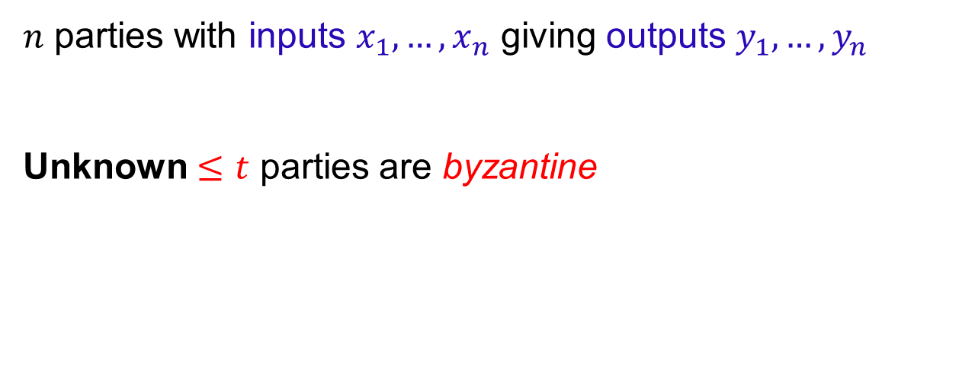
Consensus (Byzantine Agreement)
$n$ parties with inputs $x_{1}, …, x_{n}$ giving outputs $y_{1},…, y_{n}$
Unknown $≤t$ parties are byzantine
$$x_{1}$$
$$y_{1}$$
$$x_{2}$$
$$y_{2}$$
$$x_{3}$$
$$y_{3}$$
$$x_{4}$$
$$y_{4}$$
(authenticated bidirectional channels)

Slide 14
Consensus (Byzantine Agreement)
$n$ parties with inputs $x_{1}, …, x_{n}$ giving outputs $y_{1},…, y_{n}$
Unknown $≤t$ parties are byzantine
$$x_{1}$$
$$y_{1}$$
$$x_{2}$$
$$y_{2}$$
$$x_{3}$$
$$y_{3}$$
$$x_{4}$$
$$y_{4}$$
(authenticated bidirectional channels)

Slide 15
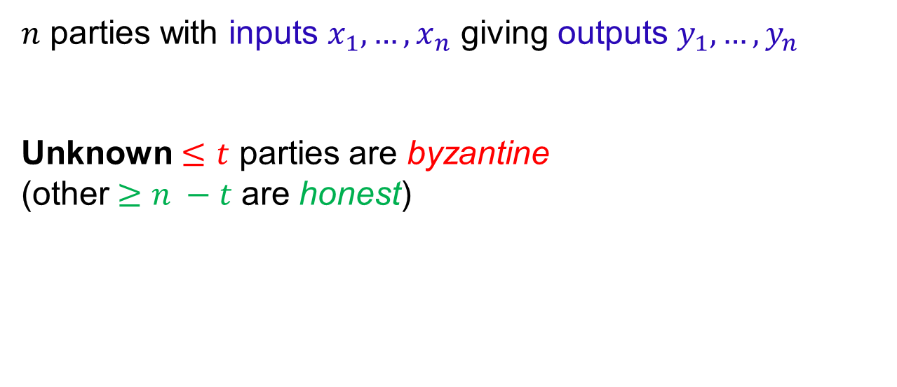
Consensus (Byzantine Agreement)
$n$ parties with inputs $x_{1}, …, x_{n}$ giving outputs $y_{1},…, y_{n}$
Unknown $≤t$ parties are byzantine
(other$≥n −t$ are honest)
$$x_{1}$$
$$y_{1}$$
$$x_{2}$$
$$y_{2}$$
$$x_{3}$$
$$y_{3}$$
$$x_{4}$$
$$y_{4}$$
(authenticated bidirectional channels)

Slide 16
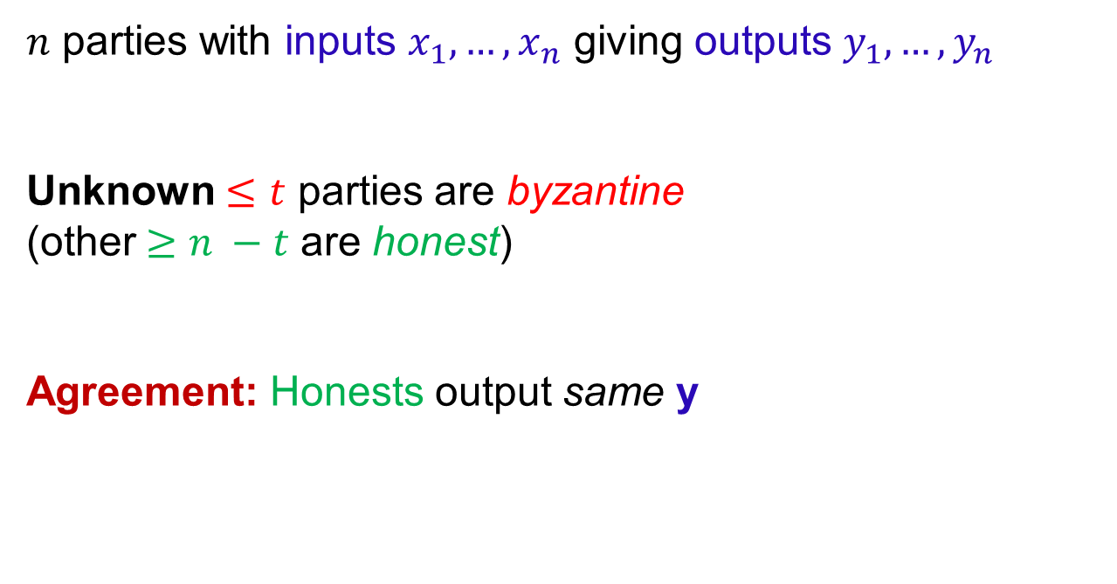
Consensus (Byzantine Agreement)
$n$ parties with inputs $x_{1}, …, x_{n}$ giving outputs $y_{1},…, y_{n}$
Unknown $≤t$ parties are byzantine
(other$≥n −t$ are honest)
Agreement: Honests output same y
$$x_{1}$$
$$y_{1}$$
$$x_{2}$$
$$y_{2}$$
$$x_{3}$$
$$y_{3}$$
$$x_{4}$$
$$y_{4}$$
(authenticated bidirectional channels)

Slide 17
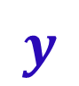

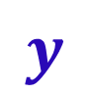
Consensus (Byzantine Agreement)
$n$ parties with inputs $x_{1}, …, x_{n}$ giving outputs $y_{1},…, y_{n}$
Unknown $≤t$ parties are byzantine
(other$≥n −t$ are honest)
Agreement: Honests output same y
$$x_{1}$$
$$y$$
$$x_{2}$$
$$y$$
$$x_{3}$$
$$y_{3}$$
$$x_{4}$$
$$y$$
(authenticated bidirectional channels)

Slide 18
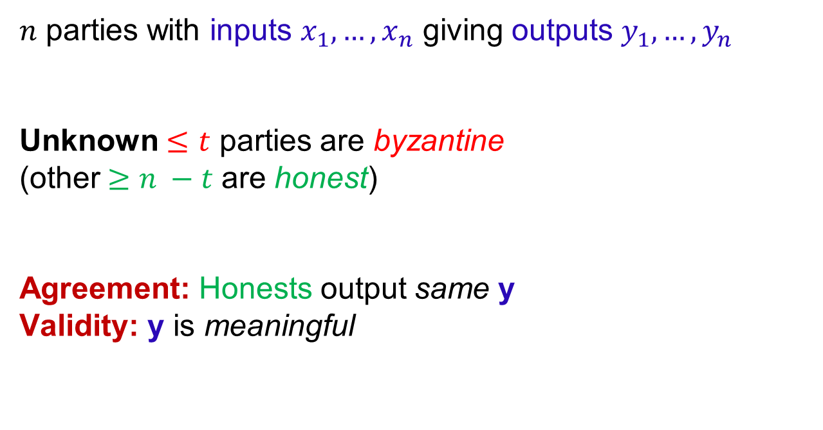
Consensus (Byzantine Agreement)
$n$ parties with inputs $x_{1}, …, x_{n}$ giving outputs $y_{1},…, y_{n}$
Unknown $≤t$ parties are byzantine
(other$≥n −t$ are honest)
Agreement: Honests output same y
Validity: y is meaningful
$$x_{1}$$
$$y$$
$$x_{2}$$
$$y$$
$$x_{3}$$
$$y_{3}$$
$$x_{4}$$
$$y$$
(authenticated bidirectional channels)

Slide 19
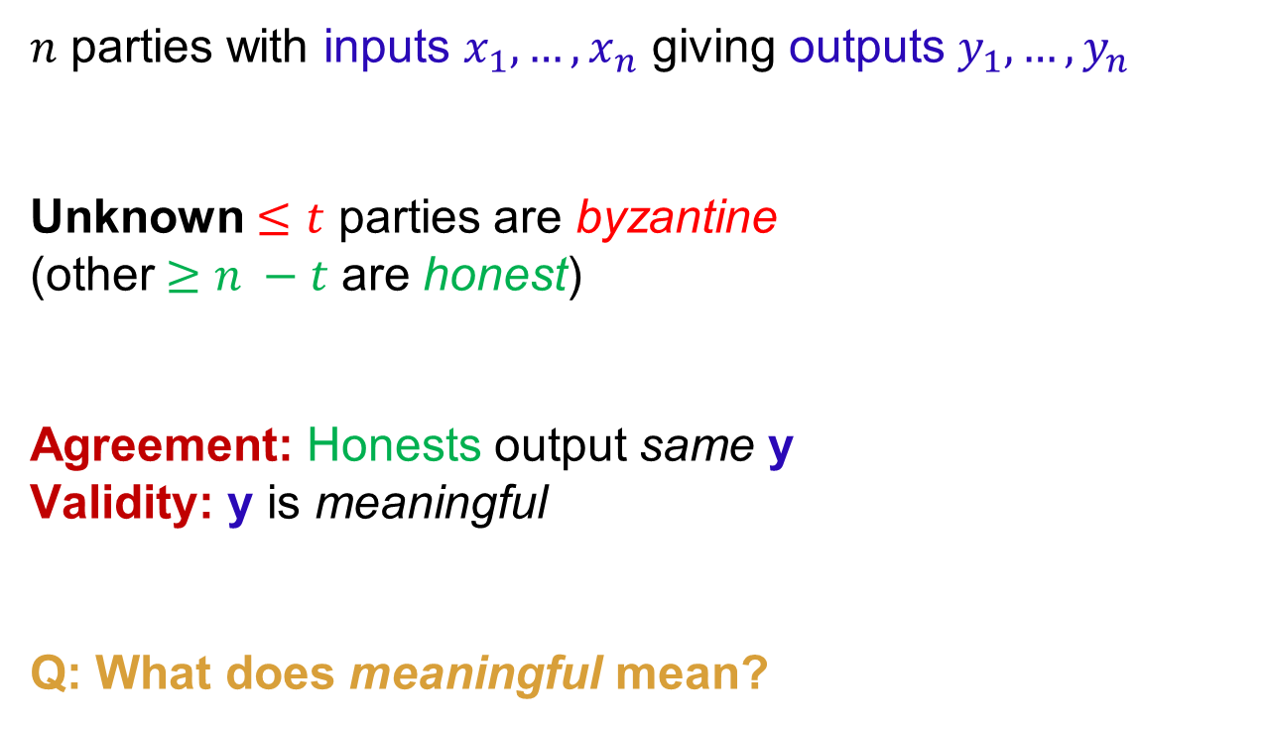
Consensus (Byzantine Agreement)
$n$ parties with inputs $x_{1}, …, x_{n}$ giving outputs $y_{1},…, y_{n}$
Unknown $≤t$ parties are byzantine
(other$≥n −t$ are honest)
Agreement: Honests output same y
Validity: y is meaningful
Q: What does meaningful mean?
$$x_{1}$$
$$y$$
$$x_{2}$$
$$y$$
$$x_{3}$$
$$y_{3}$$
$$x_{4}$$
$$y$$
(authenticated bidirectional channels)

Slide 20
Meaningful Outputs

Slide 21
Meaningful Outputs
$x_{i}∈X$

Slide 22
Meaningful Outputs
$x_{i}∈X$ (general purpose)

Slide 23
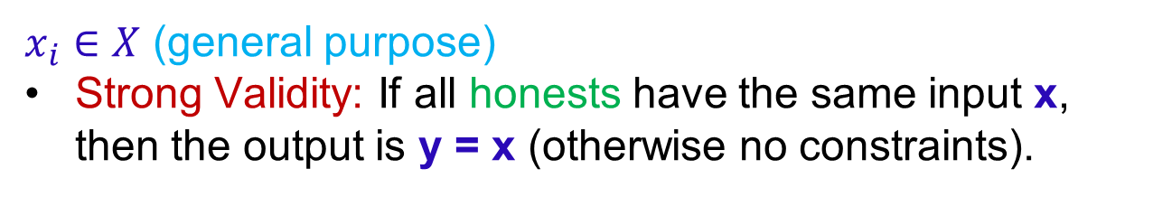
Meaningful Outputs
$x_{i}∈X$ (general purpose)
Strong Validity: If all honests have the same input x, then the output is y = x (otherwise no constraints).

Slide 24
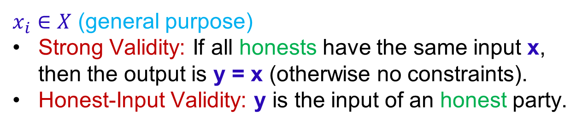
Meaningful Outputs
$x_{i}∈X$ (general purpose)
Strong Validity: If all honests have the same input x, then the output is y = x (otherwise no constraints).
Honest-Input Validity: y is the input of an honest party.

Slide 25
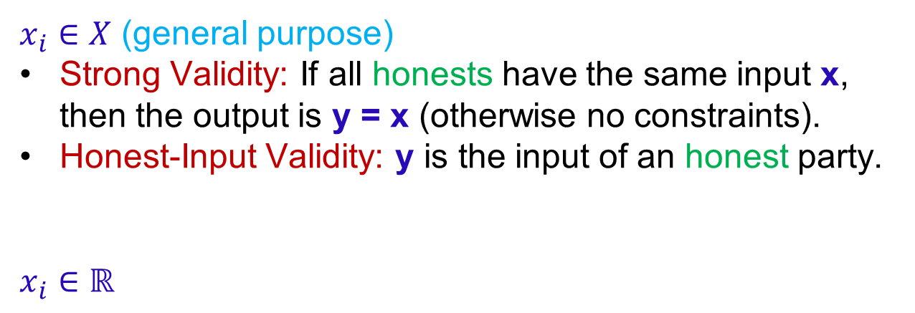
Meaningful Outputs
$x_{i}∈X$ (general purpose)
Strong Validity: If all honests have the same input x, then the output is y = x (otherwise no constraints).
Honest-Input Validity: y is the input of an honest party.
$x_{i}∈ℝ$

Slide 26
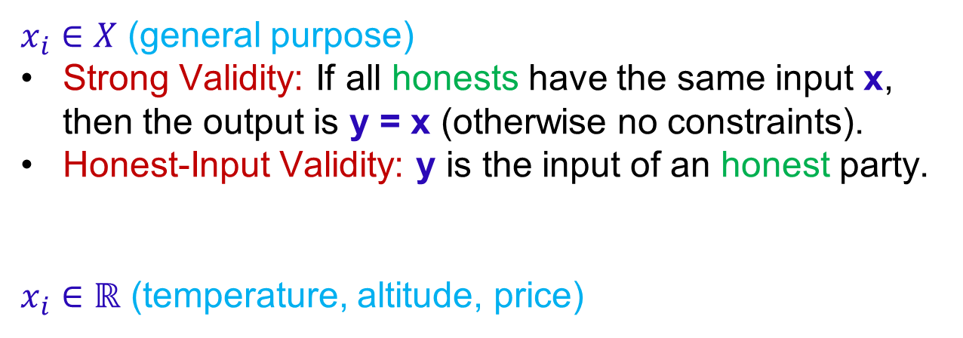
Meaningful Outputs
$x_{i}∈X$ (general purpose)
Strong Validity: If all honests have the same input x, then the output is y = x (otherwise no constraints).
Honest-Input Validity: y is the input of an honest party.
$x_{i}∈ℝ$ (temperature, altitude, price)

Slide 27
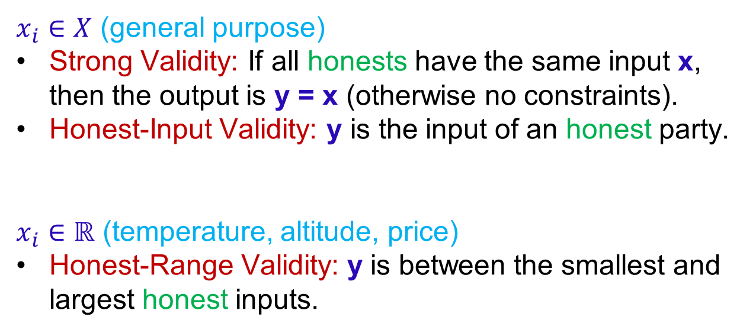
Meaningful Outputs
$x_{i}∈X$ (general purpose)
Strong Validity: If all honests have the same input x, then the output is y = x (otherwise no constraints).
Honest-Input Validity: y is the input of an honest party.
$x_{i}∈ℝ$ (temperature, altitude, price)
Honest-Range Validity: y is between the smallest and largest honest inputs.

Slide 28
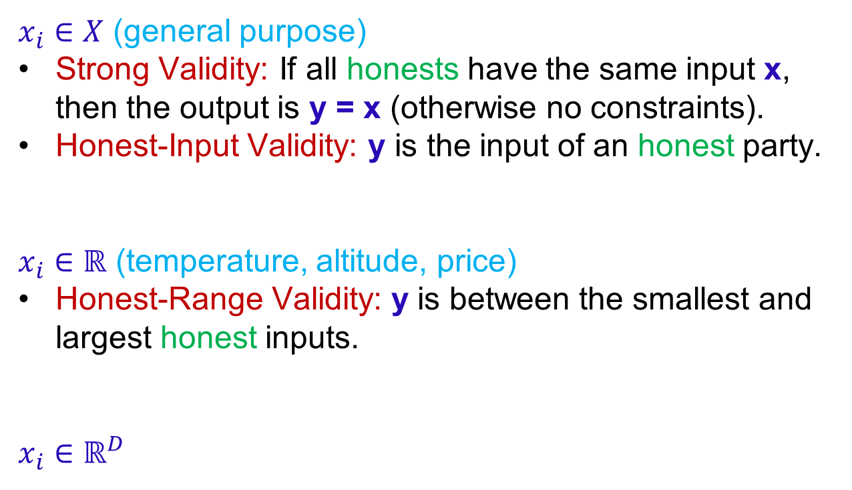
Meaningful Outputs
$x_{i}∈X$ (general purpose)
Strong Validity: If all honests have the same input x, then the output is y = x (otherwise no constraints).
Honest-Input Validity: y is the input of an honest party.
$x_{i}∈ℝ$ (temperature, altitude, price)
Honest-Range Validity: y is between the smallest and largest honest inputs.
$x_{i}∈ℝ^{D}$ (

Slide 29
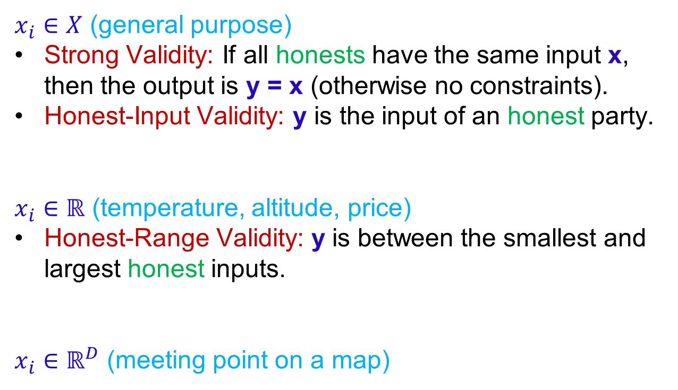
Meaningful Outputs
$x_{i}∈X$ (general purpose)
Strong Validity: If all honests have the same input x, then the output is y = x (otherwise no constraints).
Honest-Input Validity: y is the input of an honest party.
$x_{i}∈ℝ$ (temperature, altitude, price)
Honest-Range Validity: y is between the smallest and largest honest inputs.
$x_{i}∈ℝ^{D}$ (meeting point on a map)

Slide 30
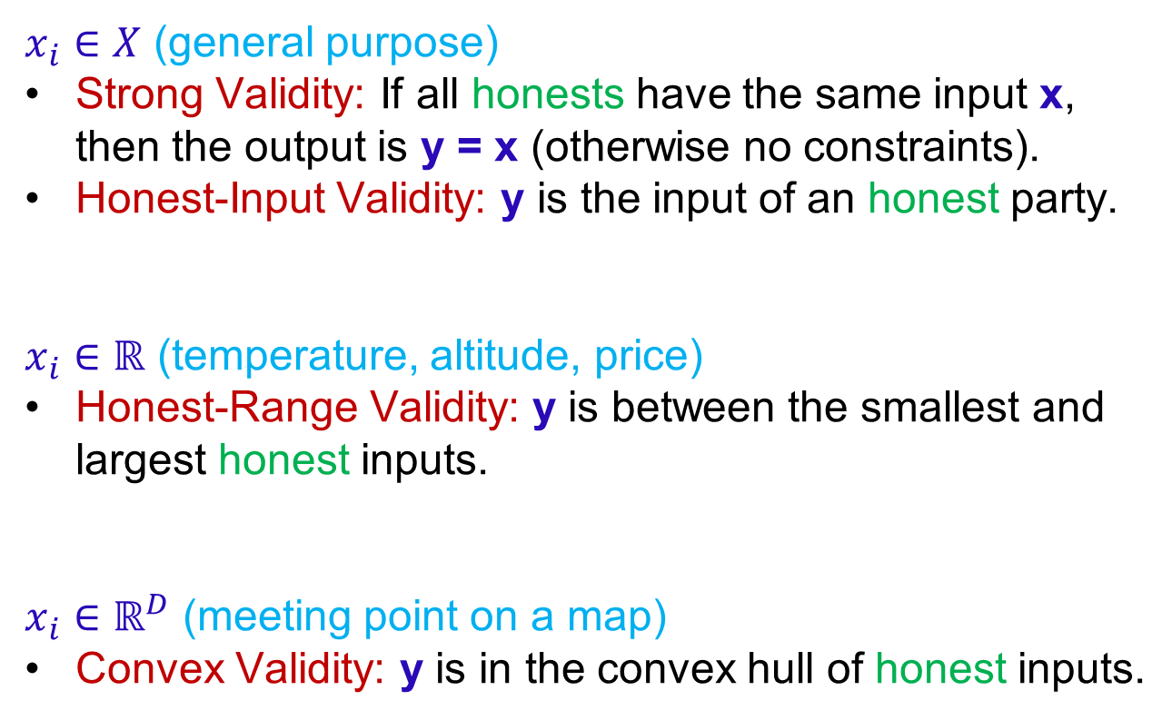
Meaningful Outputs
$x_{i}∈X$ (general purpose)
Strong Validity: If all honests have the same input x, then the output is y = x (otherwise no constraints).
Honest-Input Validity: y is the input of an honest party.
$x_{i}∈ℝ$ (temperature, altitude, price)
Honest-Range Validity: y is between the smallest and largest honest inputs.
$x_{i}∈ℝ^{D}$ (meeting point on a map)
Convex Validity: y is in the convex hull of honest inputs.

Slide 31

Meaningful Outputs
$x_{i}∈X$ (general purpose)
Strong Validity: If all honests have the same input x, then the output is y = x (otherwise no constraints).
Honest-Input Validity: y is the input of an honest party.
$x_{i}∈ℝ$ (temperature, altitude, price)
Honest-Range Validity: y is between the smallest and largest honest inputs.
$x_{i}∈ℝ^{D}$ (meeting point on a map)
Convex Validity: y is in the convex hull of honest inputs.

Slide 32
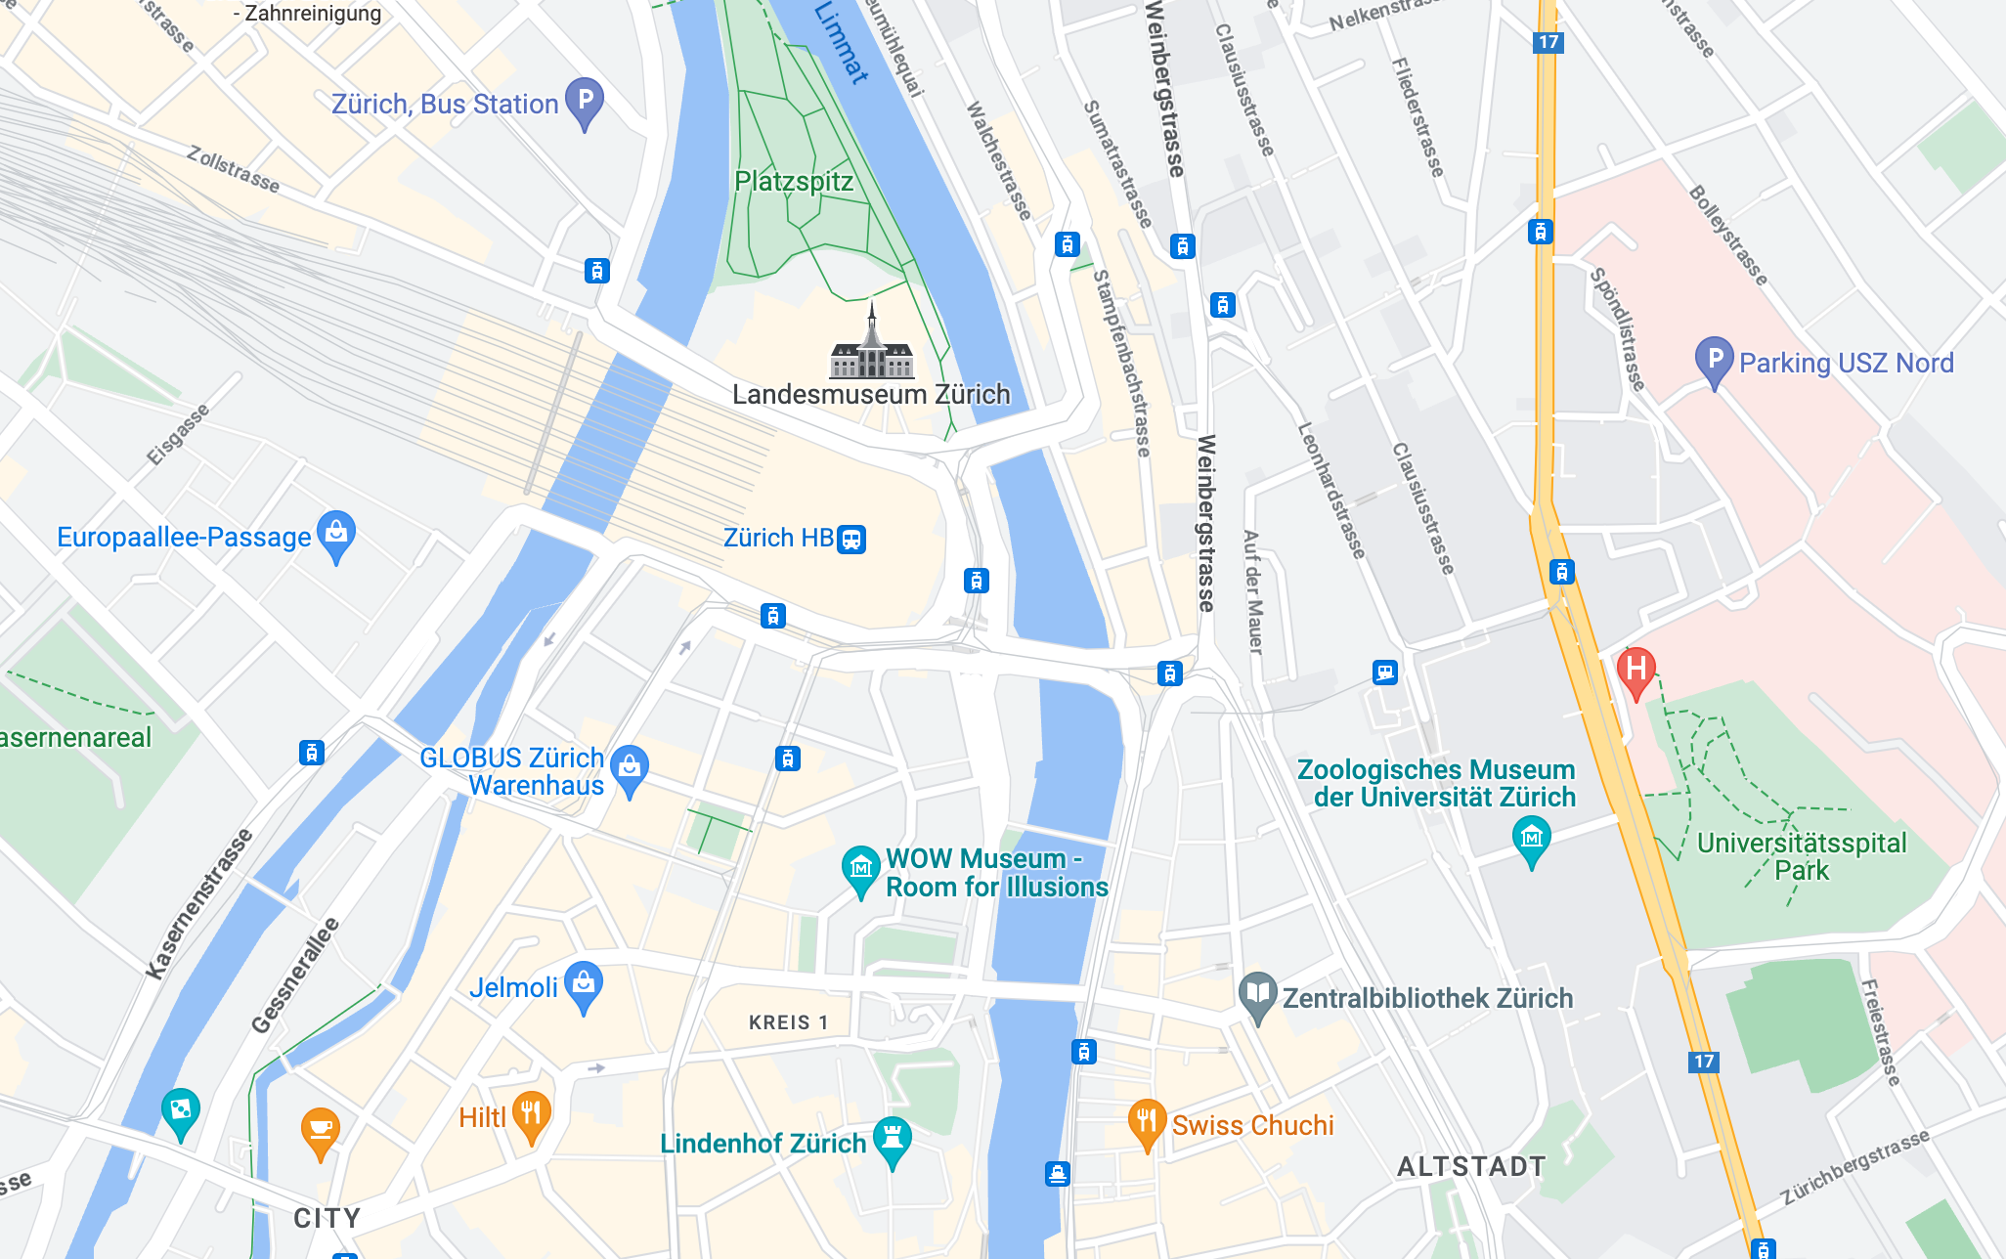

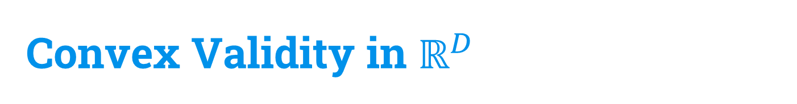
Convex Validity in $ℝ^{D}$
47.37552388.5379106
47.3760904
8.5474463
47.3762684
8.5459014
47.3689232
8.5341614

Slide 33
Convex Validity in $ℝ^{D}$
47.37552388.5379106
47.3760904
8.5474463
47.3762684
8.5459014
47.3689232
8.5341614

Slide 34
Convex Validity in $ℝ^{D}$
47.37552388.5379106
47.3760904
8.5474463
Meeting point
47.3762684
8.5459014
47.3689232
8.5341614

Slide 35
Convex Validity in $ℝ^{D}$
47.37552388.5379106
47.3760904
8.5474463
47.3762684
8.5459014
Meeting point
47.3689232
8.5341614

Slide 36
Convex Validity in $ℝ^{D}$
47.37552388.5379106
47.3760904
8.5474463
47.3762684
8.5459014
Meeting point
47.3689232
8.5341614
Q: Is there more to convexity?

Slide 37
Convex Validity in $ℝ^{D}$
47.37552388.5379106
47.3760904
8.5474463
47.3762684
8.5459014
Meeting point
47.3689232
8.5341614
river
Q: Is there more to convexity? YES!

Slide 38
Convex Validity in $ℝ^{D}$
47.37552388.5379106
47.3760904
8.5474463
47.3762684
8.5459014
Meeting point
47.3689232
8.5341614
river
Q: Is there more to convexity? YES!
Graphs

Slide 39
Convex Validity in $ℝ^{D}$
47.37552388.5379106
47.3760904
8.5474463
47.3762684
8.5459014
Meeting point
47.3689232
8.5341614
river
Q: Is there more to convexity? YES!
Graphs, lattices

Slide 40
Convex Validity in $ℝ^{D}$
47.37552388.5379106
47.3760904
8.5474463
47.3762684
8.5459014
Meeting point
47.3689232
8.5341614
river
Q: Is there more to convexity? YES!
Graphs, lattices, etc.

Slide 41
Convexity (abstractly)

Slide 42
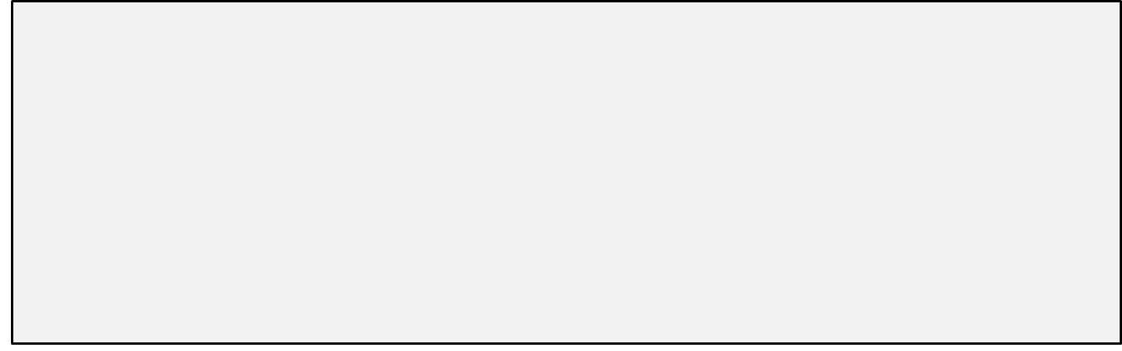
Convexity (abstractly)
The convex hull of $S⊆X$ is the intersection of all convex sets containing S.

Slide 43
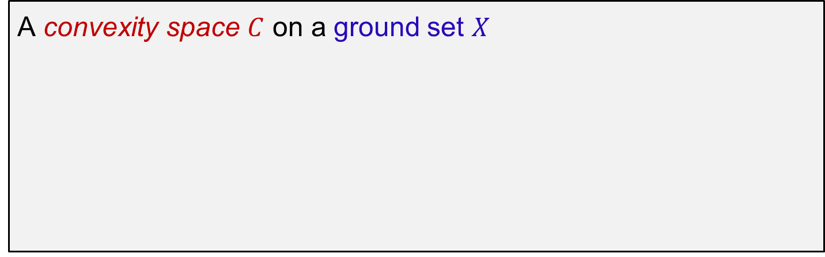
Convexity (abstractly)
A convexity space $C$ on a ground set $X$ specifies which subsets of $X$ are convex s.t.:
The convex hull of $S⊆X$ is the intersection of all convex sets containing S.

Slide 44
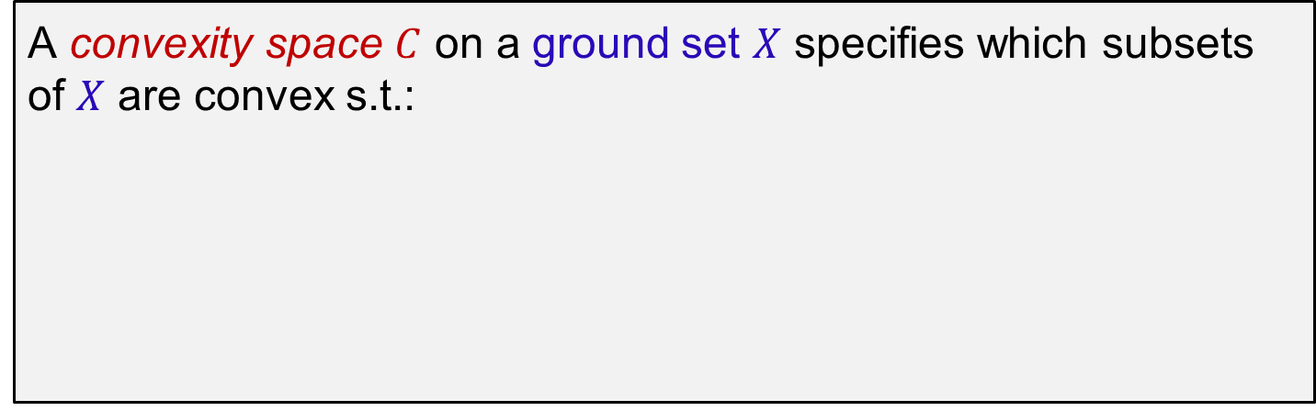
Convexity (abstractly)
A convexity space $C$ on a ground set $X$ specifies which subsets of $X$ are convex s.t.:
The convex hull of $S⊆X$ is the intersection of all convex sets containing S.

Slide 45
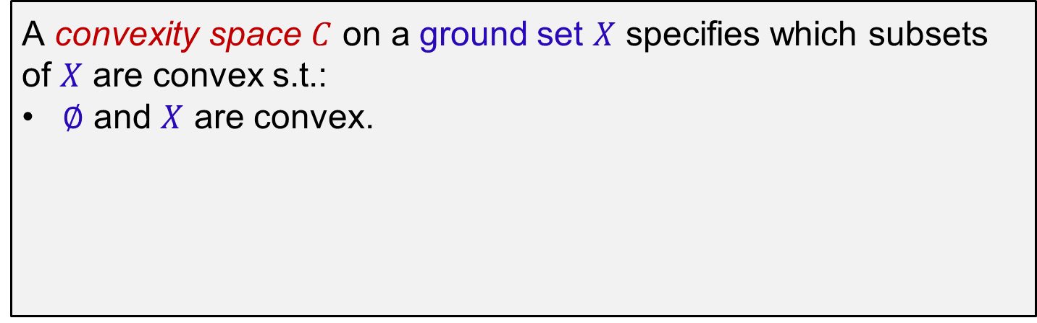
Convexity (abstractly)
A convexity space $C$ on a ground set $X$ specifies which subsets of $X$ are convex s.t.:
$∅$ and $X$ are convex.
The convex hull of $S⊆X$ is the intersection of all convex sets containing S.

Slide 46
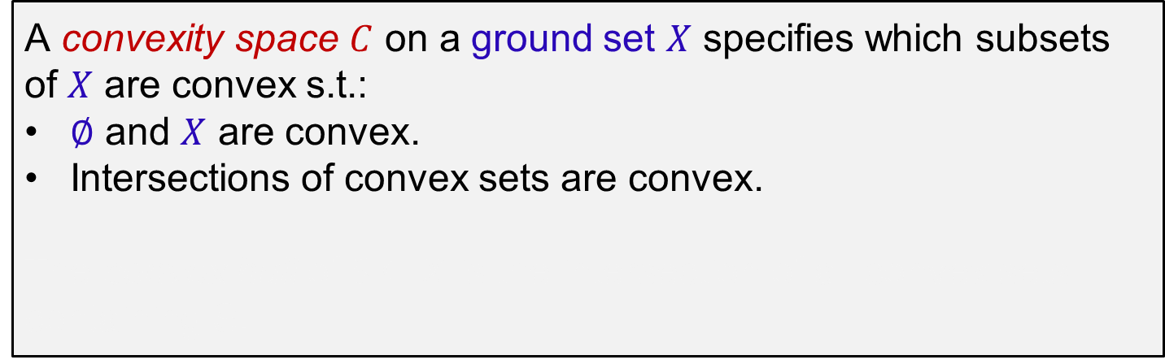
Convexity (abstractly)
A convexity space $C$ on a ground set $X$ specifies which subsets of $X$ are convex s.t.:
$∅$ and $X$ are convex.
Intersections of convex sets are convex.
The convex hull of $S⊆X$ is the intersection of all convex sets containing S.

Slide 47
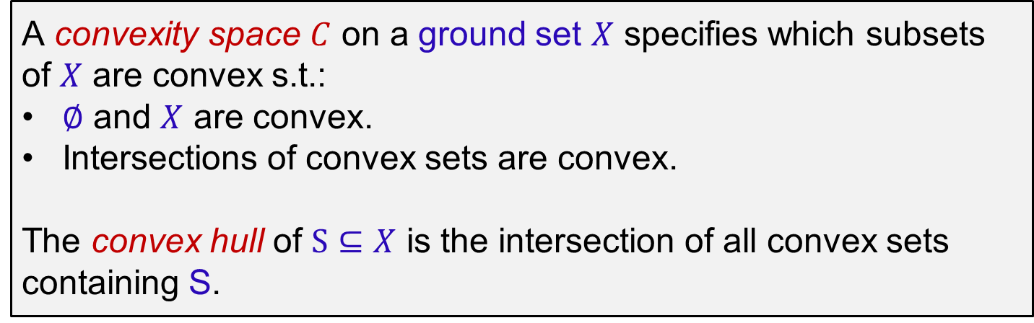
Convexity (abstractly)
A convexity space $C$ on a ground set $X$ specifies which subsets of $X$ are convex s.t.:
$∅$ and $X$ are convex.
Intersections of convex sets are convex.
The convex hull of $S⊆X$ is the intersection of all convex sets containing S.

Slide 48
Convexity (abstractly)
A convexity space $C$ on a ground set $X$ specifies which subsets of $X$ are convex s.t.:
$∅$ and $X$ are convex.
Intersections of convex sets are convex.
The convex hull of $S⊆X$ is the intersection of all convex sets containing S.
Convex Validity: output y is in the convex hull of honest inputs.

Slide 49
Convexity (abstractly)
A convexity space $C$ on a ground set $X$ specifies which subsets of $X$ are convex s.t.:
$∅$ and $X$ are convex.
Intersections of convex sets are convex.
The convex hull of $S⊆X$ is the intersection of all convex sets containing S.
Convex Validity: output y is in the convex hull of honest inputs.
Examples:

Slide 50
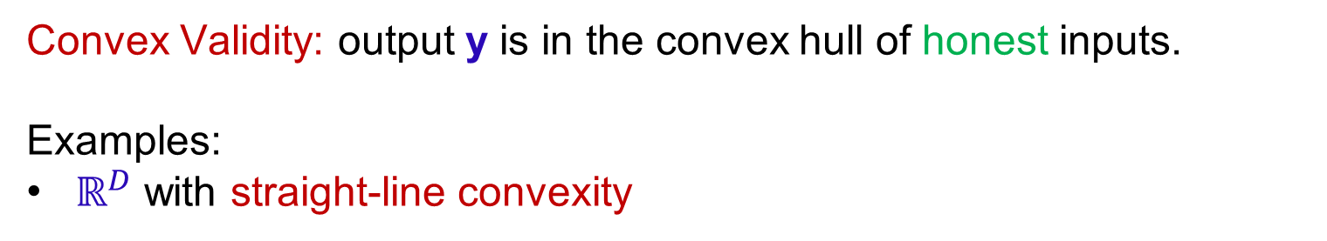
Convexity (abstractly)
A convexity space $C$ on a ground set $X$ specifies which subsets of $X$ are convex s.t.:
$∅$ and $X$ are convex.
Intersections of convex sets are convex.
The convex hull of $S⊆X$ is the intersection of all convex sets containing S.
Convex Validity: output y is in the convex hull of honest inputs.
Examples:
$ℝ^{D}$ with straight-line convexity

Slide 51
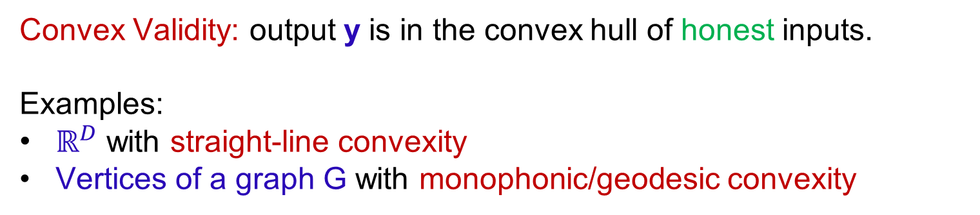
Convexity (abstractly)
A convexity space $C$ on a ground set $X$ specifies which subsets of $X$ are convex s.t.:
$∅$ and $X$ are convex.
Intersections of convex sets are convex.
The convex hull of $S⊆X$ is the intersection of all convex sets containing S.
Convex Validity: output y is in the convex hull of honest inputs.
Examples:
$ℝ^{D}$ with straight-line convexity
Vertices of a graph G with monophonic/geodesic convexity

Slide 52
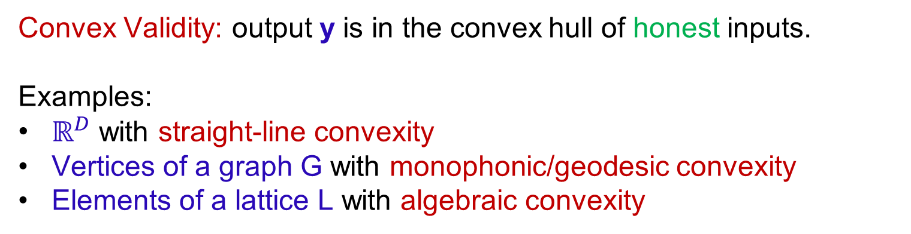
Convexity (abstractly)
A convexity space $C$ on a ground set $X$ specifies which subsets of $X$ are convex s.t.:
$∅$ and $X$ are convex.
Intersections of convex sets are convex.
The convex hull of $S⊆X$ is the intersection of all convex sets containing S.
Convex Validity: output y is in the convex hull of honest inputs.
Examples:
$ℝ^{D}$ with straight-line convexity
Vertices of a graph G with monophonic/geodesic convexity
Elements of a lattice L with algebraic convexity

Slide 53
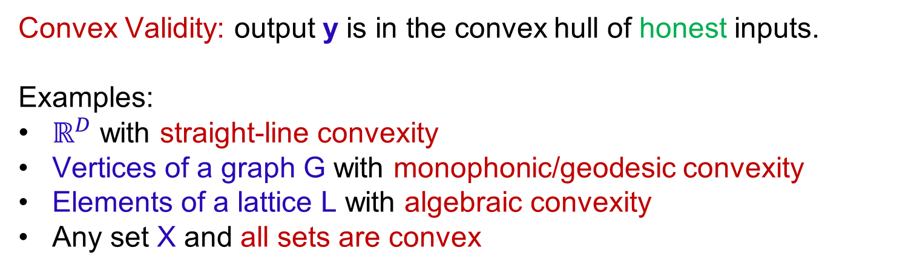
Convexity (abstractly)
A convexity space $C$ on a ground set $X$ specifies which subsets of $X$ are convex s.t.:
$∅$ and $X$ are convex.
Intersections of convex sets are convex.
The convex hull of $S⊆X$ is the intersection of all convex sets containing S.
Convex Validity: output y is in the convex hull of honest inputs.
Examples:
$ℝ^{D}$ with straight-line convexity
Vertices of a graph G with monophonic/geodesic convexity
Elements of a lattice L with algebraic convexity
Any set X and all sets are convex

Slide 54
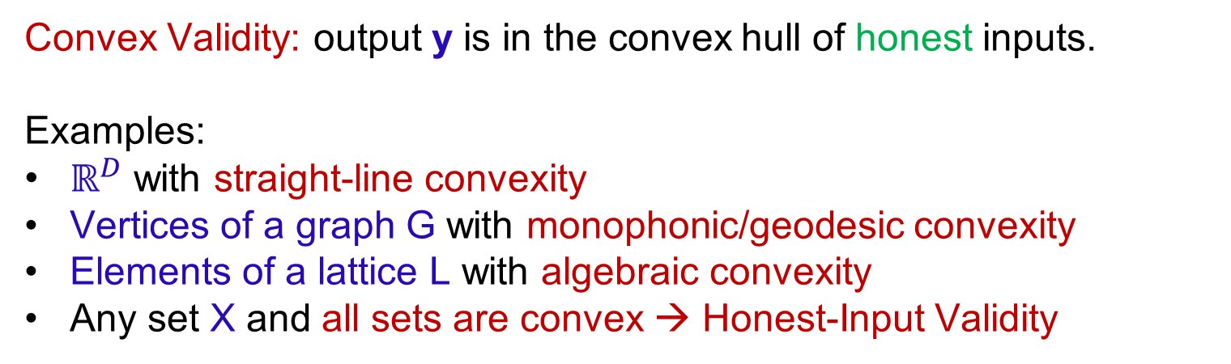
Convexity (abstractly)
A convexity space $C$ on a ground set $X$ specifies which subsets of $X$ are convex s.t.:
$∅$ and $X$ are convex.
Intersections of convex sets are convex.
The convex hull of $S⊆X$ is the intersection of all convex sets containing S.
Convex Validity: output y is in the convex hull of honest inputs.
Examples:
$ℝ^{D}$ with straight-line convexity
Vertices of a graph G with monophonic/geodesic convexity
Elements of a lattice L with algebraic convexity
Any set X and all sets are convex → Honest-Input Validity

Slide 55
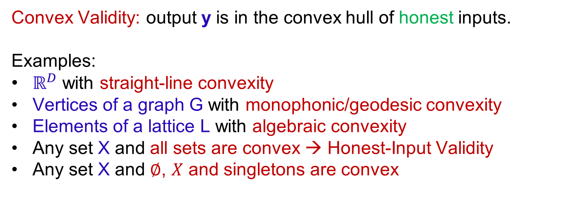
Convexity (abstractly)
A convexity space $C$ on a ground set $X$ specifies which subsets of $X$ are convex s.t.:
$∅$ and $X$ are convex.
Intersections of convex sets are convex.
The convex hull of $S⊆X$ is the intersection of all convex sets containing S.
Convex Validity: output y is in the convex hull of honest inputs.
Examples:
$ℝ^{D}$ with straight-line convexity
Vertices of a graph G with monophonic/geodesic convexity
Elements of a lattice L with algebraic convexity
Any set X and all sets are convex → Honest-Input Validity
Any set X and $∅$, $X$ and singletons are convex

Slide 56
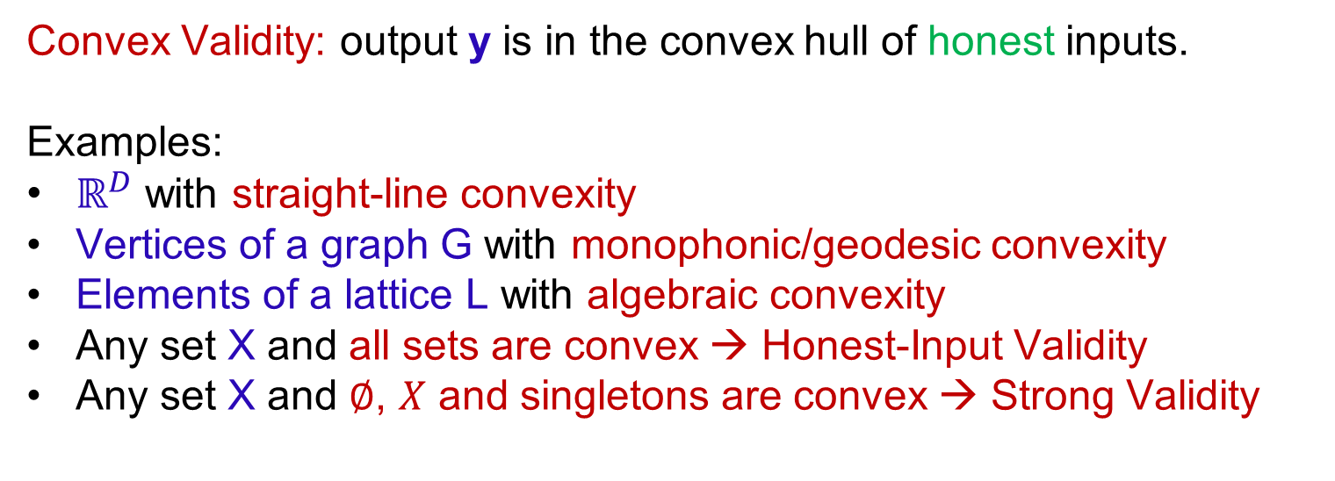
Convexity (abstractly)
A convexity space $C$ on a ground set $X$ specifies which subsets of $X$ are convex s.t.:
$∅$ and $X$ are convex.
Intersections of convex sets are convex.
The convex hull of $S⊆X$ is the intersection of all convex sets containing S.
Convex Validity: output y is in the convex hull of honest inputs.
Examples:
$ℝ^{D}$ with straight-line convexity
Vertices of a graph G with monophonic/geodesic convexity
Elements of a lattice L with algebraic convexity
Any set X and all sets are convex → Honest-Input Validity
Any set X and $∅$, $X$ and singletons are convex → Strong Validity

Slide 57
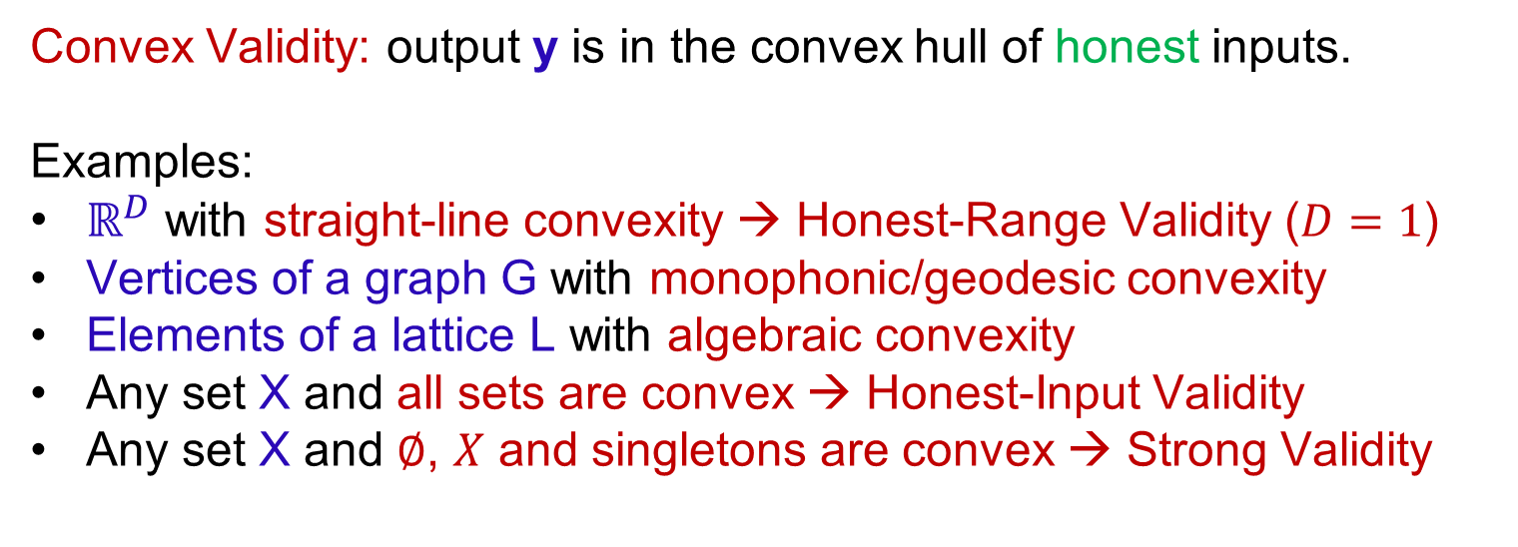
Convexity (abstractly)
A convexity space $C$ on a ground set $X$ specifies which subsets of $X$ are convex s.t.:
$∅$ and $X$ are convex.
Intersections of convex sets are convex.
The convex hull of $S⊆X$ is the intersection of all convex sets containing S.
Convex Validity: output y is in the convex hull of honest inputs.
Examples:
$ℝ^{D}$ with straight-line convexity → Honest-Range Validity ($D=1$)
Vertices of a graph G with monophonic/geodesic convexity
Elements of a lattice L with algebraic convexity
Any set X and all sets are convex → Honest-Input Validity
Any set X and $∅$, $X$ and singletons are convex → Strong Validity

Slide 59
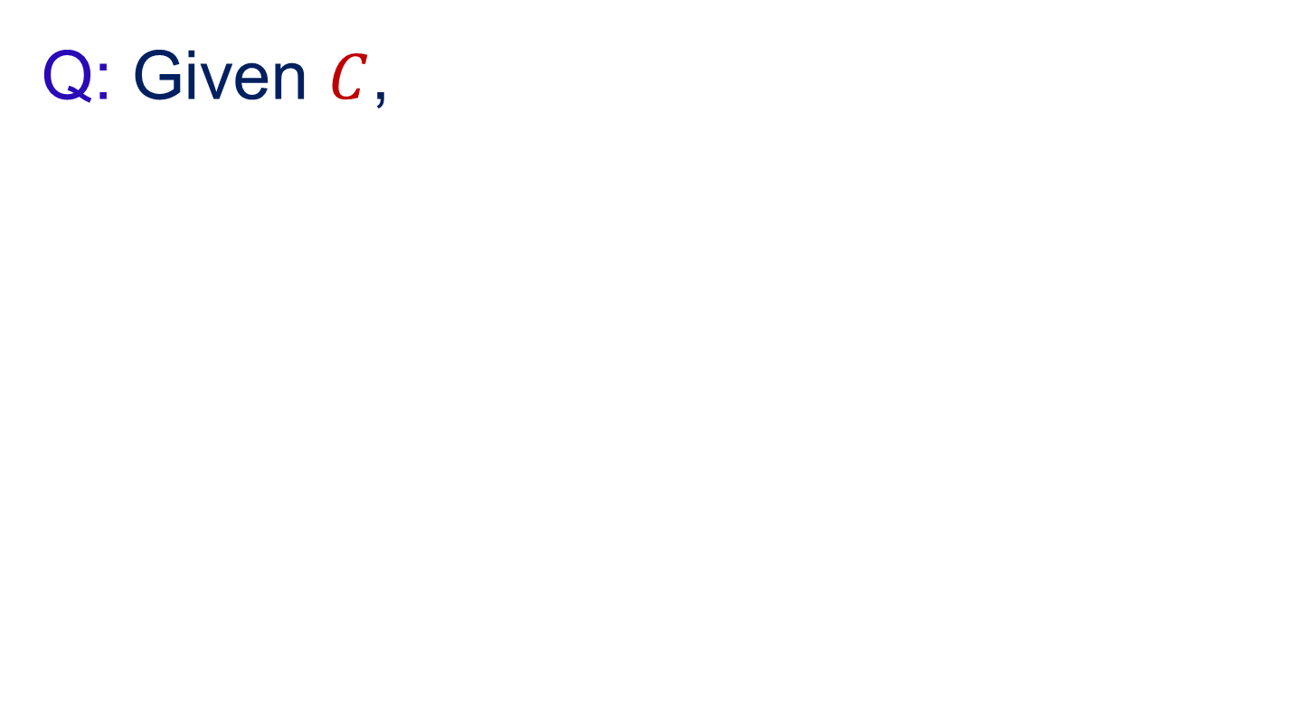
Q: Given $C$, find largest $t$ s.t. we can achieve Agreement and Convex Validity for $≤t$ corruptions? A: depends on the network model. Pb.: How can we even specify t? $ω$

Slide 60
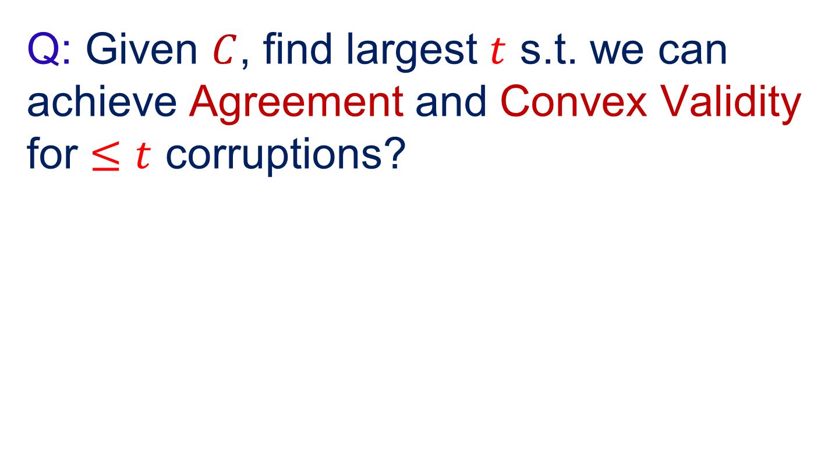
Q: Given $C$, find largest $t$ s.t. we can achieve Agreement and Convex Validity for $≤t$ corruptions? A: depends on the network model. Pb.: How can we even specify t? $ω$

Slide 61
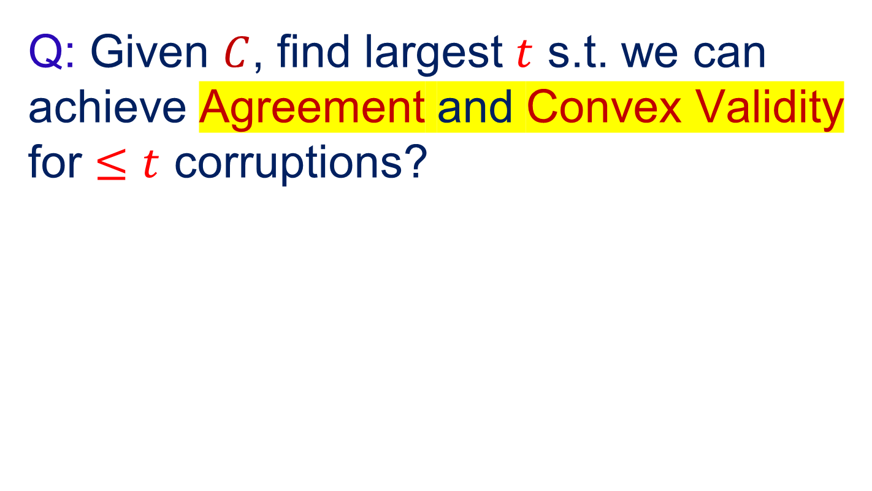
Q: Given $C$, find largest $t$ s.t. we can achieve Agreement and Convex Validity for $≤t$ corruptions? A: depends on the network model. Pb.: How can we even specify t? $ω$
Convex Consensus (CC)

Slide 62

Q: Given $C$, find largest $t$ s.t. we can achieve Agreement and Convex Validity for $≤t$ corruptions? A: depends on the network model. Pb.: How can we even specify t? $ω$
Convex Consensus (CC)

Slide 63
2.
A geometric invariant
The Helly number
Notes:
Motivating example

Slide 64
Helly’s Theorem

Slide 65
Helly’s Theorem
Helly’s Theorem:

Slide 66

Helly’s Theorem
Helly’s Theorem:
Given family of convex sets in $ℝ^{D}$ (with straight-line convexity):

Slide 67

Helly’s Theorem
Helly’s Theorem:
Given family of convex sets in $ℝ^{D}$ (with straight-line convexity):
Every $D + 1$ intersect $⇒$ all of them intersect.

Slide 68

Helly’s Theorem
Helly’s Theorem:
Given family of convex sets in $ℝ^{D}$ (with straight-line convexity):
Every $D + 1$ intersect $⇒$ all of them intersect.
Example:

Slide 69

Helly’s Theorem
Helly’s Theorem:
Given family of convex sets in $ℝ^{D}$ (with straight-line convexity):
Every $D + 1$ intersect $⇒$ all of them intersect.
Example:
100 disks in $ℝ^{2}$

Slide 70

Helly’s Theorem
Helly’s Theorem:
Given family of convex sets in $ℝ^{D}$ (with straight-line convexity):
Every $D + 1$ intersect $⇒$ all of them intersect.
Example:
100 disks in $ℝ^{2}$: every 3 intersect

Slide 71

Helly’s Theorem
Helly’s Theorem:
Given family of convex sets in $ℝ^{D}$ (with straight-line convexity):
Every $D + 1$ intersect $⇒$ all of them intersect.
Example:
100 disks in $ℝ^{2}$: every 3 intersect $⇒$all 100 intersect.

Slide 72

Helly’s Theorem
Helly’s Theorem:
Given family of convex sets in $ℝ^{D}$ (with straight-line convexity):
Every $D + 1$ intersect $⇒$ all of them intersect.
Example:
100 disks in $ℝ^{2}$: every 3 intersect $⇒$all 100 intersect.
(every 2 intersect $⇒$all 100 intersect)

Slide 73
Helly’s Theorem
Helly’s Theorem:
Given family of convex sets in $ℝ^{D}$ (with straight-line convexity):
Every $D + 1$ intersect $⇒$ all of them intersect.
Example:
100 disks in $ℝ^{2}$: every 3 intersect $⇒$all 100 intersect.
(every 2 intersect $⇒$all 100 intersect)

Slide 74

Helly’s Theorem
Helly’s Theorem:
Given family of convex sets in $ℝ^{D}$ (with straight-line convexity):
Every $D + 1$ intersect $⇒$ all of them intersect.
Example:
100 disks in $ℝ^{2}$: every 3 intersect $⇒$all 100 intersect.
(every 2 intersect $⇒$all 100 intersect)
Helly’s Theorem (abstract):

Slide 75

Helly’s Theorem
Helly’s Theorem:
Given family of convex sets in $ℝ^{D}$ (with straight-line convexity):
Every $D + 1$ intersect $⇒$ all of them intersect.
Example:
100 disks in $ℝ^{2}$: every 3 intersect $⇒$all 100 intersect.
(every 2 intersect $⇒$all 100 intersect)
Helly’s Theorem (abstract):
Given family of convex sets in a convexity space $C\text{:}$
Every $ω$ intersect $⇒$ all of them intersect.

Slide 76

Helly’s Theorem
Helly’s Theorem:
Given family of convex sets in $ℝ^{D}$ (with straight-line convexity):
Every $D + 1$ intersect $⇒$ all of them intersect.
Example:
100 disks in $ℝ^{2}$: every 3 intersect $⇒$all 100 intersect.
(every 2 intersect $⇒$all 100 intersect)
Helly’s Theorem (abstract):
Given family of convex sets in a convexity space $C\text{:}$
Every $ω$ intersect $⇒$ all of them intersect.
Helly number of $C$

Slide 77
Q: Given $C$, find largest $t$ s.t. we can achieve Agreement and Convex Validity for $≤t$ corruptions? A: depends on the network model. Pb.: How can we even specify t? $ω$
Convex Consensus (CC)

Slide 78

Q: Given $C$, find largest $t$ s.t. we can achieve Agreement and Convex Validity for $≤t$ corruptions? A: depends on the network model. Pb.: How can we even specify t? $ω$
Convex Consensus (CC)

Slide 79

Q: Given $C$, find largest $t$ s.t. we can achieve Agreement and Convex Validity for $≤t$ corruptions? A: depends on network model. Pb.: How can we even specify t? $ω$
Convex Consensus (CC)

Slide 80
3.
(A)synchrony
And the best-of-both-worlds
Notes:
Motivating example

Slide 81
Network Models

Slide 82

Network Models
Synchronous model: messages get delivered within a known amount of time $Δ$.

Slide 83

Network Models
Synchronous model: messages get delivered within a known amount of time $Δ$.
Problem: small deviations from $Δ$ break the protocol.

Slide 84

Network Models
Synchronous model: messages get delivered within a known amount of time $Δ$.
Problem: small deviations from $Δ$ break the protocol.
Asynchronous model: messages get delivered eventually.

Slide 85

Network Models
Synchronous model: messages get delivered within a known amount of time $Δ$.
Problem: small deviations from $Δ$ break the protocol.
Asynchronous model: messages get delivered eventually.
Problem: requires lower $t$.

Slide 86

Network Models
Synchronous model: messages get delivered within a known amount of time $Δ$.
Problem: small deviations from $Δ$ break the protocol.
Asynchronous model: messages get delivered eventually.
Problem: requires lower $t$.
A tradeoff? Can we somehow get the best of both worlds?

Slide 87

Network Models
Synchronous model: messages get delivered within a known amount of time $Δ$.
Problem: small deviations from $Δ$ break the protocol.
Asynchronous model: messages get delivered eventually.
Problem: requires lower $t$.
A tradeoff? Can we somehow get the best of both worlds?
Network-agnostic model:

Slide 88

Network Models
Synchronous model: messages get delivered within a known amount of time $Δ$.
Problem: small deviations from $Δ$ break the protocol.
Asynchronous model: messages get delivered eventually.
Problem: requires lower $t$.
A tradeoff? Can we somehow get the best of both worlds?
Network-agnostic model: Given $t_{a}≤t_{s}$:

Slide 89

Network Models
Synchronous model: messages get delivered within a known amount of time $Δ$.
Problem: small deviations from $Δ$ break the protocol.
Asynchronous model: messages get delivered eventually.
Problem: requires lower $t$.
A tradeoff? Can we somehow get the best of both worlds?
Network-agnostic model: Given $t_{a}≤t_{s}$:
Tolerate $t_{s}$ corruptions if the network is synchronous.

Slide 90

Network Models
Synchronous model: messages get delivered within a known amount of time $Δ$.
Problem: small deviations from $Δ$ break the protocol.
Asynchronous model: messages get delivered eventually.
Problem: requires lower $t$.
A tradeoff? Can we somehow get the best of both worlds?
Network-agnostic model: Given $t_{a}≤t_{s}$:
Tolerate $t_{s}$ corruptions if the network is synchronous.
Tolerate $t_{a}$ corruptions if the network is asynchronous.

Slide 91

Network Models
Synchronous model: messages get delivered within a known amount of time $Δ$.
Problem: small deviations from $Δ$ break the protocol.
Asynchronous model: messages get delivered eventually.
Problem: requires lower $t$.
A tradeoff? Can we somehow get the best of both worlds?
Network-agnostic model: Given $t_{a}≤t_{s}$:
Tolerate $t_{s}$ corruptions if the network is synchronous.
Tolerate $t_{a}$ corruptions if the network is asynchronous.
The protocol does not know which one is the case!

Slide 92

Network Models
Synchronous model: messages get delivered within a known amount of time $Δ$.
Problem: small deviations from $Δ$ break the protocol.
Asynchronous model: messages get delivered eventually.
Problem: requires lower $t$.
A tradeoff? Can we somehow get the best of both worlds?
Network-agnostic model: Given $t_{a}≤t_{s}$:
Tolerate $t_{s}$ corruptions if the network is synchronous.
Tolerate $t_{a}$ corruptions if the network is asynchronous.
The protocol does not know which one is the case!
(Question here: what pairs $(t_{s}, t_{a})$ are possible?)

Slide 93
4.
Results
Tight results for all 3 models!
Notes:
Motivating example

Slide 94
CC Solvable Iff

Slide 95

CC Solvable Iff
Synchronous model: $t<\frac{n}{ω}$
Asynchronous model: $t<\frac{n}{ω+1}$

Slide 96

CC Solvable Iff
Synchronous model: $t<\frac{n}{ω}$
Asynchronous model: $t<\frac{n}{ω+1}$

Slide 97

CC Solvable Iff
Synchronous model: $t<\frac{n}{ω}$
Asynchronous model: $t<\frac{n}{ω+1}$

Slide 98

CC Solvable Iff
Synchronous model: $t<\frac{n}{ω}$
Asynchronous model: $t<\frac{n}{ω+1}$

Slide 99

CC Solvable Iff
Synchronous model: $t<\frac{n}{ω}$
Asynchronous model: $t<\frac{n}{ω+1}$
Network-agnostic model:

Slide 100

CC Solvable Iff
Synchronous model: $t<\frac{n}{ω}$
Asynchronous model: $t<\frac{n}{ω+1}$
Network-agnostic model:$ωt_{s}<n$

Slide 101

CC Solvable Iff
Synchronous model: $t<\frac{n}{ω}$
Asynchronous model: $t<\frac{n}{ω+1}$
Network-agnostic model: $max\left(ωt_{s}, ωt_{a}+t_{s}\right)<n$

Slide 102

CC Solvable Iff
Synchronous model: $t<\frac{n}{ω}$
Asynchronous model: $t<\frac{n}{ω+1}$
Network-agnostic model: $max\left(ωt_{s}, ωt_{a}+t_{s}, 2t_{s}+t_{a}\right)<n$

Slide 103

CC Solvable Iff
Synchronous model: $t<\frac{n}{ω}$
Asynchronous model: $t<\frac{n}{ω+1}$
Network-agnostic model: $max\left(ωt_{s}, ωt_{a}+t_{s}, 2t_{s}+t_{a}\right)<n$

Slide 104
CC Solvable Iff
Synchronous model: $t<\frac{n}{ω}$
Asynchronous model: $t<\frac{n}{ω+1}$
Network-agnostic model: $max\left(ωt_{s}, ωt_{a}+t_{s}, 2t_{s}+t_{a}\right)<n$
Imp
Pos
Imp
Pos
Pos
Imp1
Imp2
Imp3

Slide 105
CC Solvable Iff
Synchronous model: $t<\frac{n}{ω}$
Asynchronous model: $t<\frac{n}{ω+1}$
Network-agnostic model: $max\left(ωt_{s}, ωt_{a}+t_{s}, 2t_{s}+t_{a}\right)<n$
Imp
Pos
Imp
Pos
Pos
Imp1
Imp2
Imp3

Slide 106

$t=\frac{n}{ω}$ is impossible

Slide 107

$t=\frac{n}{ω}$ is impossible
Example for $ℝ^{2}$: $t=\frac{n}{3}$ is impossible.

Slide 108

$t=\frac{n}{ω}$ is impossible
Example for $ℝ^{2}$: $t=\frac{n}{3}$ is impossible.

Slide 109

$t=\frac{n}{ω}$ is impossible
Example for $ℝ^{2}$: $t=\frac{n}{3}$ is impossible.

Slide 110

$t=\frac{n}{ω}$ is impossible
Example for $ℝ^{2}$: $t=\frac{n}{3}$ is impossible.

Slide 111
$t=\frac{n}{ω}$ is impossible
Example for $ℝ^{2}$: $t=\frac{n}{3}$ is impossible.

Slide 112
$t=\frac{n}{ω}$ is impossible
Example for $ℝ^{2}$: $t=\frac{n}{3}$ is impossible.

Slide 113
$t=\frac{n}{ω}$ is impossible
Example for $ℝ^{2}$: $t=\frac{n}{3}$ is impossible.

Slide 114
$t=\frac{n}{ω}$ is impossible
Example for $ℝ^{2}$: $t=\frac{n}{3}$ is impossible.

Slide 115


$t=\frac{n}{ω}$ is impossible
Example for $ℝ^{2}$: $t=\frac{n}{3}$ is impossible.

Slide 116

$t=\frac{n}{ω}$ is impossible
Example for $ℝ^{2}$: $t=\frac{n}{3}$ is impossible.
General convexity spaces $C$:

Slide 117

$t=\frac{n}{ω}$ is impossible
Example for $ℝ^{2}$: $t=\frac{n}{3}$ is impossible.
General convexity spaces $C$:
$ω$ parties, 1 corrupted.

Slide 118

$t=\frac{n}{ω}$ is impossible
Example for $ℝ^{2}$: $t=\frac{n}{3}$ is impossible.
General convexity spaces $C$:
$ω$ parties, 1 corrupted.
Bad instance guaranteed by def. of $ω$.

Slide 119

$t=\frac{n}{ω}$ is impossible
Example for $ℝ^{2}$: $t=\frac{n}{3}$ is impossible.
General convexity spaces $C$:
$ω$ parties, 1 corrupted.
Bad instance guaranteed by def. of $ω$.
Previously known: $ℝ^{D}$ and convex geometries.

Slide 120
Protocol (Possibility)

Slide 121
Protocol (Possibility)
A) Parties distribute inputs to get a common view on $\left(x_{1},…, x_{n}\right)$:

Slide 122

Protocol (Possibility)
A) Parties distribute inputs to get a common view on $\left(x_{1},…, x_{n}\right)$:
(some values unknown: $x_{i}= ⊥$)

Slide 123

Protocol (Possibility)
A) Parties distribute inputs to get a common view on $\left(x_{1},…, x_{n}\right)$:
(some values unknown: $x_{i}= ⊥$)
Known honest values are correct;

Slide 124

Protocol (Possibility)
A) Parties distribute inputs to get a common view on $\left(x_{1},…, x_{n}\right)$:
(some values unknown: $x_{i}= ⊥$)
Known honest values are correct;
$≥n −t_{s}$ values known;

Slide 125

Protocol (Possibility)
A) Parties distribute inputs to get a common view on $\left(x_{1},…, x_{n}\right)$:
(some values unknown: $x_{i}= ⊥$)
Known honest values are correct;
$≥n −t_{s}$ values known;
Synchronous network $⇒$ all honest values known.

Slide 126

Protocol (Possibility)
A) Parties distribute inputs to get a common view on $\left(x_{1},…, x_{n}\right)$:
(some values unknown: $x_{i}= ⊥$)
Known honest values are correct;
$≥n −t_{s}$ values known;
Synchronous network $⇒$ all honest values known.
“Core-Set Agreement” for $2 t_{s}+t_{a}<n$

Slide 127

Protocol (Possibility)
A) Parties distribute inputs to get a common view on $\left(x_{1},…, x_{n}\right)$:
(some values unknown: $x_{i}= ⊥$)
Known honest values are correct;
$≥n −t_{s}$ values known;
Synchronous network $⇒$ all honest values known.
“Core-Set Agreement” for $2 t_{s}+t_{a}<n$ (main tech. novelty)

Slide 128

Protocol (Possibility)
A) Parties distribute inputs to get a common view on $\left(x_{1},…, x_{n}\right)$:
(some values unknown: $x_{i}= ⊥$)
Known honest values are correct;
$≥n −t_{s}$ values known;
Synchronous network $⇒$ all honest values known.
“Core-Set Agreement” for $2 t_{s}+t_{a}<n$ (main tech. novelty)
B) Parties locally and deterministically compute a valid output

Slide 129

Protocol (Possibility)
A) Parties distribute inputs to get a common view on $\left(x_{1},…, x_{n}\right)$:
(some values unknown: $x_{i}= ⊥$)
Known honest values are correct;
$≥n −t_{s}$ values known;
Synchronous network $⇒$ all honest values known.
“Core-Set Agreement” for $2 t_{s}+t_{a}<n$ (main tech. novelty)
B) Parties locally and deterministically compute a valid output by taking the “safe area”

Slide 130

Protocol (Possibility)
A) Parties distribute inputs to get a common view on $\left(x_{1},…, x_{n}\right)$:
(some values unknown: $x_{i}= ⊥$)
Known honest values are correct;
$≥n −t_{s}$ values known;
Synchronous network $⇒$ all honest values known.
“Core-Set Agreement” for $2 t_{s}+t_{a}<n$ (main tech. novelty)
B) Parties locally and deterministically compute a valid output by taking the “safe area” (Agreement is for free).

Slide 131
Safe Area

Slide 132
Safe Area
e.g., $4$ values in the common view, $≤1$corrupted, what to do?

Slide 133
Safe Area
e.g., $4$ values in the common view, $≤1$corrupted, what to do?

Slide 134
Safe Area
e.g., $4$ values in the common view, $≤1$corrupted, what to do?

Slide 135
Safe Area
e.g., 4 values in the common view, $≤1$corrupted, what to do?

Slide 136
Safe Area
e.g., 4 values in the common view, $≤1$corrupted, what to do?

Slide 137
Safe Area
e.g., $4$ values in the common view, $≤1$corrupted, what to do?

Slide 138
Safe Area
e.g., $4$ values in the common view, $≤1$corrupted, what to do?

Slide 139
Safe Area
e.g., $4$ values in the common view, $≤1$corrupted, what to do?

Slide 140
Safe Area
e.g., $4$ values in the common view, $≤1$corrupted, what to do?

Slide 141
Safe Area
e.g., $4$ values in the common view, $≤1$corrupted, what to do?

Slide 142
Safe Area
e.g., $4$ values in the common view, $≤1$corrupted, what to do?

Slide 143
Safe Area
e.g., $4$ values in the common view, $≤1$corrupted, what to do?

Slide 144
Safe Area
e.g., $4$ values in the common view, $≤1$corrupted, what to do?

Slide 145

Safe Area
e.g., $4$ values in the common view, $≤1$corrupted, what to do?
Generally: $a$ values in the common view, $≤b$corrupted

Slide 146

Safe Area
e.g., $4$ values in the common view, $≤1$corrupted, what to do?
Generally: $a$ values in the common view, $≤b$corrupted
Safe area: intersection of convex hulls of subsets of size $a – b$

Slide 147

Safe Area
e.g., $4$ values in the common view, $≤1$corrupted, what to do?
Generally: $a$ values in the common view, $≤b$corrupted
Safe area: intersection of convex hulls of subsets of size $a – b$
Any point in safe area is valid, select one deterministically.

Slide 148
Safe Area (cont’d)

Slide 149
Safe Area (cont’d)
Who are $a$and $b$?

Slide 150

Safe Area (cont’d)
Who are $a$and $b$?
The common view has $≥n −t_{s}$ values,

Slide 151

Safe Area (cont’d)
Who are $a$and $b$?
The common view has $≥n −t_{s}$ values, say $a= n −t_{s}+k$.

Slide 152

Safe Area (cont’d)
Who are $a$and $b$?
The common view has $≥n −t_{s}$ values, say $a= n −t_{s}+k$.
The network is synchronous?

Slide 153

Safe Area (cont’d)
Who are $a$and $b$?
The common view has $≥n −t_{s}$ values, say $a= n −t_{s}+k$.
The network is synchronous?
⇒ at most $k$ of these values are corrupted.

Slide 154

Safe Area (cont’d)
Who are $a$and $b$?
The common view has $≥n −t_{s}$ values, say $a= n −t_{s}+k$.
The network is synchronous?
⇒ at most $k$ of these values are corrupted.
The network is asynchronous?

Slide 155

Safe Area (cont’d)
Who are $a$and $b$?
The common view has $≥n −t_{s}$ values, say $a= n −t_{s}+k$.
The network is synchronous?
⇒ at most $k$ of these values are corrupted.
The network is asynchronous?
⇒ at most $t_{a}$ of these values are corrupted.

Slide 156

Safe Area (cont’d)
Who are $a$and $b$?
The common view has $≥n −t_{s}$ values, say $a= n −t_{s}+k$.
The network is synchronous?
⇒ at most $k$ of these values are corrupted.
The network is asynchronous?
⇒ at most $t_{a}$ of these values are corrupted.
We don’t know which?

Slide 157

Safe Area (cont’d)
Who are $a$and $b$?
The common view has $≥n −t_{s}$ values, say $a= n −t_{s}+k$.
The network is synchronous?
⇒ at most $k$ of these values are corrupted.
The network is asynchronous?
⇒ at most $t_{a}$ of these values are corrupted.
We don’t know which?
⇒ $b=max⁡(k, t_{a})$

Slide 158

Safe Area (cont’d)
Who are $a$and $b$?
The common view has $≥n −t_{s}$ values, say $a= n −t_{s}+k$.
The network is synchronous?
⇒ at most $k$ of these values are corrupted.
The network is asynchronous?
⇒ at most $t_{a}$ of these values are corrupted.
We don’t know which?
⇒ $b=max⁡(k, t_{a})$
Q: Why is the safe area non-empty?

Slide 159

Safe Area (cont’d)
Who are $a$and $b$?
The common view has $≥n −t_{s}$ values, say $a= n −t_{s}+k$.
The network is synchronous?
⇒ at most $k$ of these values are corrupted.
The network is asynchronous?
⇒ at most $t_{a}$ of these values are corrupted.
We don’t know which?
⇒ $b=max⁡(k, t_{a})$
Q: Why is the safe area non-empty?
A: We intersect many convex sets,

Slide 160

Safe Area (cont’d)
Who are $a$and $b$?
The common view has $≥n −t_{s}$ values, say $a= n −t_{s}+k$.
The network is synchronous?
⇒ at most $k$ of these values are corrupted.
The network is asynchronous?
⇒ at most $t_{a}$ of these values are corrupted.
We don’t know which?
⇒ $b=max⁡(k, t_{a})$
Q: Why is the safe area non-empty?
A: We intersect many convex sets, but it suffices to show any $ω$ intersect;

Slide 161

Safe Area (cont’d)
Who are $a$and $b$?
The common view has $≥n −t_{s}$ values, say $a= n −t_{s}+k$.
The network is synchronous?
⇒ at most $k$ of these values are corrupted.
The network is asynchronous?
⇒ at most $t_{a}$ of these values are corrupted.
We don’t know which?
⇒ $b=max⁡(k, t_{a})$
Q: Why is the safe area non-empty?
A: We intersect many convex sets, but it suffices to show any $ω$ intersect; Pigeonhole Principle;

Slide 162

Safe Area (cont’d)
Who are $a$and $b$?
The common view has $≥n −t_{s}$ values, say $a= n −t_{s}+k$.
The network is synchronous?
⇒ at most $k$ of these values are corrupted.
The network is asynchronous?
⇒ at most $t_{a}$ of these values are corrupted.
We don’t know which?
⇒ $b=max⁡(k, t_{a})$
Q: Why is the safe area non-empty?
A: We intersect many convex sets, but it suffices to show any $ω$ intersect; Pigeonhole Principle; $max\left(ωt_{s}, ωt_{a}+t_{s}\right)<n$

Slide 163

5.
Outlook
And shameless self-advertising
Notes:
Motivating example

Slide 165
Convex Validity
Honest-Range Validity
Strong Validity
Honest-Input Validity

Slide 166

Convex Validity
Honest-Range Validity
Strong Validity
Honest-Input Validity

Slide 167
Convex Validity
Weak Validity
Honest-Range Validity
Strong Validity
Honest-Input Validity

Slide 168
Convex Validity
Weak Validity
Pareto Validity
Honest-Range Validity
Median Validity
Strong Validity
Honest-Input Validity
Voting Validity
…

Slide 169


Convex Validity
Weak Validity
Pareto Validity
Honest-Range Validity
Median Validity
Strong Validity
Honest-Input Validity
Voting Validity
…

Slide 170
Convex Validity
Weak Validity
Pareto Validity
Honest-Range Validity
Median Validity
Strong Validity
Honest-Input Validity
Voting Validity
arXiv’24
…

Slide 171
Convex Validity
Weak Validity
Pareto Validity
Honest-Range Validity
Median Validity
Strong Validity
Honest-Input Validity
Voting Validity
arXiv’24
…
Approximate Agreement?

Slide 172
Convex Validity
Weak Validity
Pareto Validity
Honest-Range Validity
Median Validity
Strong Validity
Honest-Input Validity
Voting Validity
arXiv’24
…
Approximate Agreement?
Other adversaries?

Slide 173

Hope you enjoyed!

Slide 174

Hope you enjoyed!

